Slide 1

AutoCAD
AUTODESK
COURSE SLIDES · WSQ
WSQ Technical Drawing with AutoCAD
WSQ Course Code: TGS-2021005538
Skills Framework TSC: Technical Drawing (DSN-TDR-3005-1.11)
Conducted by Tertiary Infotech Academy Pte Ltd · UEN 201200696W
Version v12 · 18 August 2026
© 2026 Tertiary Infotech Academy Pte Ltd. All rights reserved. · www.tertiarycourses.com.sg

Slide 2
COURSE ADMINISTRATION
Welcome & Housekeeping
WSQ Technical Drawing with AutoCAD · TGS-2021005538
© 2026 Tertiary Infotech Academy Pte Ltd
2

Slide 3
TRAQOM · SSG DIGITAL ATTENDANCE
Digital Attendance (Mandatory)
• It is mandatory to take the AM, PM and Assessment digital attendance for WSQ-funded courses.
• The trainer/administrator displays the digital attendance QR code from the SSG portal.
• Scan the QR code with your mobile phone camera and submit your attendance.
• A minimum of 75% attendance is required to be eligible for assessment and funding.
WSQ Technical Drawing with AutoCAD · TGS-2021005538
© 2026 Tertiary Infotech Academy Pte Ltd
3

Slide 4
YOUR TRAINER · GENERAL
About the Trainer
NAME
____________________________________________
?
TITLE / DESIGNATION
____________________________________________
QUALIFICATIONS
____________________________________________
Your Trainer
AREAS OF EXPERTISE
____________________________________________
General Trainer template —
to be completed by the trainer
TRAINING & INDUSTRY EXPERIENCE
____________________________________________
CONTACT
____________________________________________
WSQ Technical Drawing with AutoCAD · TGS-2021005538
© 2026 Tertiary Infotech Academy Pte Ltd
4

Slide 5
YOUR TRAINER
About the Trainer
ROLE
Principal Trainer, Tertiary Infotech Academy Pte Ltd
AA
SPECIALISATION
CAD, technical drawing and engineering design — AutoCAD, Revit and Fusion 360.
Dr Alfred Ang
DELIVERS
WSQ courses on technical drawing, design and emerging technologies.
Principal Trainer
Tertiary Infotech Academy Pte Ltd
FOUNDER
Founder and lead instructor at Tertiary Infotech / Tertiary Courses.
WSQ Technical Drawing with AutoCAD · TGS-2021005538
© 2026 Tertiary Infotech Academy Pte Ltd
5

Slide 6
ICE-BREAKER
Let's Know Each Other
• Your name and organisation / role.
• Your experience with CAD, drafting or design (if any).
• What you want to be able to draw or document after this course.
WSQ Technical Drawing with AutoCAD · TGS-2021005538
© 2026 Tertiary Infotech Academy Pte Ltd
6

Slide 7
HOUSEKEEPING
Ground Rules
Set your mobile phone to silent mode.
Participate actively — no question is stupid.
1
2
Mutual respect: agree to disagree.
One conversation at one time.
3
4
Be punctual; return from breaks on time.
75% attendance is required.
5
6
WSQ Technical Drawing with AutoCAD · TGS-2021005538
© 2026 Tertiary Infotech Academy Pte Ltd
7

Slide 8

COURSE PORTAL · LMS/TMS
Download Course Material
• Log in to the LMS/TMS portal with the account created at registration.
• Portal: https://lms-tms.tertiaryinfotech.com
• Open your course → Course Materials to download the slides and Learner Guide.
• Keep them handy — the final assessment is open book (slides, Learner Guide and approved materials only).
WSQ Technical Drawing with AutoCAD · TGS-2021005538
© 2026 Tertiary Infotech Academy Pte Ltd
8

Slide 9
SCHEDULE
Lesson Plan — 2 Days, 8 hours/day
Day 1
Day 2
• Day 1 — AutoCAD Foundations, Drawing & Modifying Objects
– Digital attendance (AM) · introductions · outcomes
– Topic 1: Getting Started with AutoCAD (Lab 1)
– Topic 2: Technical Drawing with AutoCAD (Labs 2–5)
– Topic 3: Modifying Objects (Labs 6–8)
• Day 2 — Organizing Objects, Design Documentation & Assessment
– Topic 4: Organizing Objects (Labs 9–12)
– Topic 5: Design Documentation (Labs 13–16)
– Course feedback & TRAQOM survey
– Final Assessment: WA (SAQ) + Practical Performance
– Daily timing: 9:30am–6:30pm · 1-hour lunch
WSQ Technical Drawing with AutoCAD · TGS-2021005538
© 2026 Tertiary Infotech Academy Pte Ltd
9

Slide 10
WSQ ALIGNMENT
Skills Framework — TSC
TSC Title
Technical Drawing
TSC Code
DSN-TDR-3005-1.11
1
2
Framework
Skills Framework for Design — Technical Drawing, Proficiency Level 3.
Coverage
Five abilities (A1–A5) and five knowledge areas (K1–K5) mapped to the five course topics.
3
4
WSQ Technical Drawing with AutoCAD · TGS-2021005538
© 2026 Tertiary Infotech Academy Pte Ltd
10

Slide 11
SKILLS FRAMEWORK TSC
TSC Abilities & Knowledge
Abilities
Knowledge
• A1: Read and visualise technical drawings according to briefs
• A2: Produce two-dimensional (2D) and three-dimensional (3D) technical drawings based on input from stakeholders
• A3: Create part lists for new design to facilitate technical drawing
• A4: Oversee the development and construction of new designs' prototypes, in collaboration with organisation's production function
• A5: Produce drawings and specifications, that conform to the requirements of relevant standards for submission
• K1: Symbols, standards and conventions used in technical drawings within one's field and region
• K2: Methods of technical drawing by instruments and computer-aided design (CAD) systems
• K3: Types of technical drawings
• K4: Fundamentals of drafting design documentation
• K5: Concepts of information technology (IT) to facilitate the usage of technical drawing software
WSQ Technical Drawing with AutoCAD · TGS-2021005538
© 2026 Tertiary Infotech Academy Pte Ltd
11

Slide 12
WHAT YOU'LL ACHIEVE
Learning Outcomes
LO1 — Read
Read and visualize AutoCAD technical drawings.
LO2 — Produce
Produce 2D and 3D technical drawings using AutoCAD.
1
2
LO3 — Part lists
Create part lists using AutoCAD blocks, attributes and tables.
LO4 — Document
Create AutoCAD design documentation — text, dimensions, annotation.
3
4
LO5 — Specify
Produce design specification: layouts, viewports and plotted sheets.
5
WSQ Technical Drawing with AutoCAD · TGS-2021005538
© 2026 Tertiary Infotech Academy Pte Ltd
12

Slide 13
FIVE TOPICS · 16 HANDS-ON LABS
Course Outline
Day 1
Day 2
• Topic 1: Getting Started with AutoCAD (A1, K1)
– AutoCAD user interface
– Workspace settings, navigation and units
• Topic 2: Technical Drawing with AutoCAD (A2, K2)
– Basic AutoCAD operations
– Drawing objects and isometric drawing
• Topic 3: Modifying Objects (A3, K3)
– Working with modifiers: move, copy, trim, arrays…
• Topic 4: Organizing Objects (A4, K4)
– Object properties and layers
– Blocks, attributes and reusable content
• Topic 5: Design Documentation (A5, K5)
– Text, dimensions and part-list tables
– Layouts, printing and outputs
– Annotative techniques
WSQ Technical Drawing with AutoCAD · TGS-2021005538
© 2026 Tertiary Infotech Academy Pte Ltd
13

Slide 14
ASSESSMENT RULES
Briefing for Assessment
• Place phones and other materials under the table or on the floor.
• No photos or recording of assessment scripts.
• No discussion during the assessment.
• Use a black/blue pen for hard-copy assessments.
• No liquid paper / correction tape.
• Scripts are collected when time is up.
WSQ Technical Drawing with AutoCAD · TGS-2021005538
© 2026 Tertiary Infotech Academy Pte Ltd
14

Slide 15
FINAL ASSESSMENT
Final Assessment
• Written Assessment (WA) — Short-Answer Questions (SAQ), 1 hour, open book.
• Practical Performance (PP) — produce a dimensioned AutoCAD technical drawing, 1.5 hours, open book.
• Format: Open Book — slides, Learner Guide and approved materials only.
• A minimum of 75% attendance (SSG Digital Attendance record) and a 'Competent' assessment result are required for funding.
• An appeal process is available if required.
WSQ Technical Drawing with AutoCAD · TGS-2021005538
© 2026 Tertiary Infotech Academy Pte Ltd
15

Slide 16
ON ASSESSMENT DAY
Assessment Flow
1
2
3
4
5
▶
▶
▶
▶
TRAQOM survey — scan the QR code on the LMS
Assessment digital attendance — scan the SSG QR
Sit WA (SAQ) then Practical Performance — open book
Submit your answers and DWG file on the LMS
Sign the Assessment Summary Record
WSQ Technical Drawing with AutoCAD · TGS-2021005538
© 2026 Tertiary Infotech Academy Pte Ltd
16

Slide 17
CORE CONCEPTS
Technical Drawing & CAD Fundamentals
WSQ Technical Drawing with AutoCAD · TGS-2021005538
© 2026 Tertiary Infotech Academy Pte Ltd
17

Slide 18
K1 · K3 — STANDARDS, CONVENTIONS & TYPES
What is a Technical Drawing?
Precise communication
A technical drawing communicates a design's exact geometry, sizes and finishes for manufacture or construction.
Standards-based
Symbols, line conventions, projections and dimensioning follow standards (ISO/ANSI) so any reader interprets it the same way.
1
2
Types
Orthographic multi-view, isometric/pictorial, section, detail and assembly drawings — each answers a different question.
CAD advantage
AutoCAD makes drawings precise, editable, layered, reusable and printable at any scale.
3
4
WSQ Technical Drawing with AutoCAD · TGS-2021005538
© 2026 Tertiary Infotech Academy Pte Ltd
18

Slide 19
METHODOLOGY
The Technical Drawing Workflow
Set up & draw
Organise & refine
Document & publish
• Template, units and limits
• Precision aids: snap, ortho, polar
• Draw geometry at 1:1
• Layers, properties, blocks
• Modify: trim, fillet, array
• Attributes for part data
• Dimensions, text and tables
• Layouts with scaled viewports
• Plot to PDF for submission
WSQ Technical Drawing with AutoCAD · TGS-2021005538
© 2026 Tertiary Infotech Academy Pte Ltd
19

Slide 20
01
TOPIC 01
Getting Started with AutoCAD
AutoCAD User Interface · Workspace Settings · Navigation · Units
WSQ Technical Drawing with AutoCAD · TGS-2021005538
© 2026 Tertiary Infotech Academy Pte Ltd
20

Slide 21
SKILLS FRAMEWORK A1 · K1
Key Concepts — Getting Started with AutoCAD
User interface
Application menu, Quick Access Toolbar, ribbon tabs and panels, drawing area, command window and status bar.
Workspaces
Drafting & Annotation, 3D Basics and 3D Modeling — task-oriented sets of ribbons, menus and palettes.
1
2
Model vs paper space
Design at 1:1 in model space; compose scaled drawing sheets in paper-space layouts.
Precision aids
Grid and snap, ortho mode, polar tracking, object snaps and dynamic input keep every pick exact.
3
4
Navigation
Zoom, pan, ViewCube and the wheel mouse move you around a drawing without changing it.
Units and limits
UNITS sets the length/angle format and precision; LIMITS frames the working area of the drawing.
5
6
WSQ Technical Drawing with AutoCAD · TGS-2021005538
© 2026 Tertiary Infotech Academy Pte Ltd
21

Slide 22
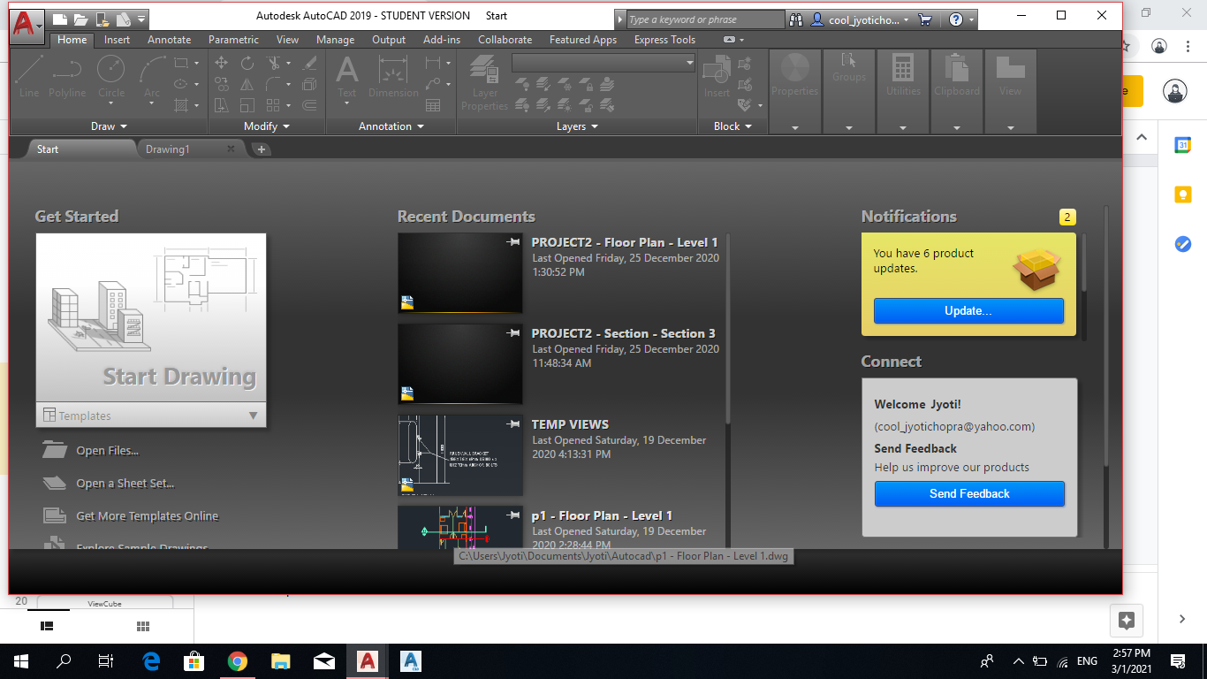
USER INTERFACE
AutoCAD User Interface — Application Menu
• The Application button opens the file-level menu: create, open and save drawings.
• Audit, recover and purge a drawing file when it needs repair or cleanup.
• Print or publish a file, and access the Options dialog for system settings.
• Recent documents are listed for quick reopening.
WSQ Technical Drawing with AutoCAD · TGS-2021005538
© 2026 Tertiary Infotech Academy Pte Ltd
22

Slide 23
USER INTERFACE
Starting a New Drawing
• Start New Drawing creates a file from the default drawing template (DWT).
• Metric drawings use acadiso.dwt; imperial drawings use acad.dwt.
• The default template is set in the Options dialog.
• Templates carry units, styles, layers and title blocks — start right, draw less.
WSQ Technical Drawing with AutoCAD · TGS-2021005538
© 2026 Tertiary Infotech Academy Pte Ltd
23

Slide 24
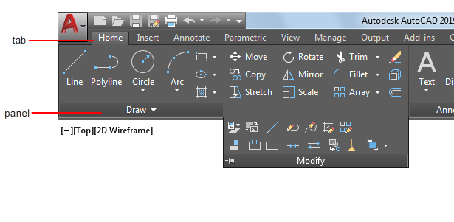
USER INTERFACE
Ribbon Tabs and Panels
• The ribbon organises tools into tabs (Home, Insert, Annotate, View, Output…).
• Each tab is a set of panels — Draw, Modify, Layers, Annotation and more.
• Panels expand to reveal less-used tools; pin them open while learning.
• Most course commands live on the Home tab's Draw and Modify panels.
WSQ Technical Drawing with AutoCAD · TGS-2021005538
© 2026 Tertiary Infotech Academy Pte Ltd
24

Slide 25
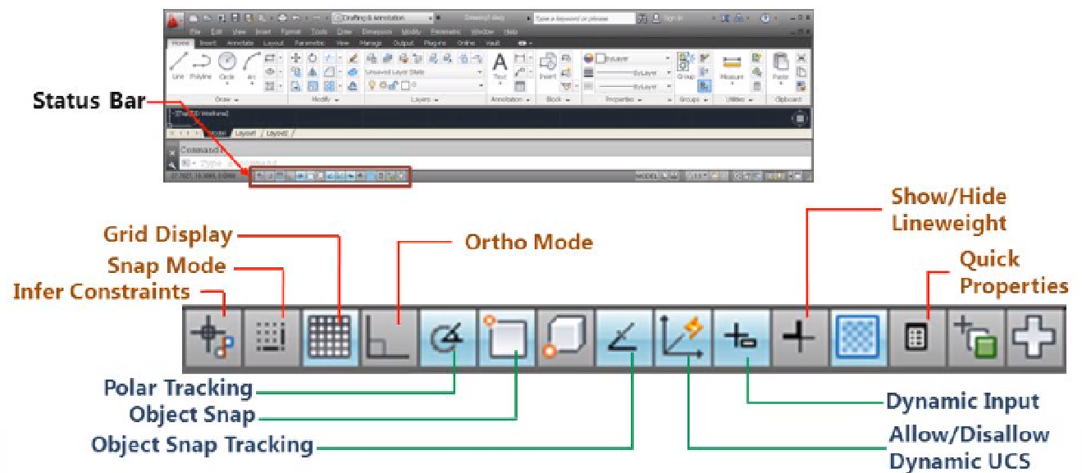
USER INTERFACE
Status Bar — Precision Drafting Aids
• The status bar toggles grid, snap, ortho, polar tracking and object snap.
• Ortho constrains the cursor to horizontal/vertical; Polar tracks set angles.
• 2D object snap picks exact endpoints, midpoints, centres and intersections.
• Function keys mirror the toggles: F7 grid · F8 ortho · F9 snap · F10 polar · F3 osnap.
WSQ Technical Drawing with AutoCAD · TGS-2021005538
© 2026 Tertiary Infotech Academy Pte Ltd
25

Slide 26
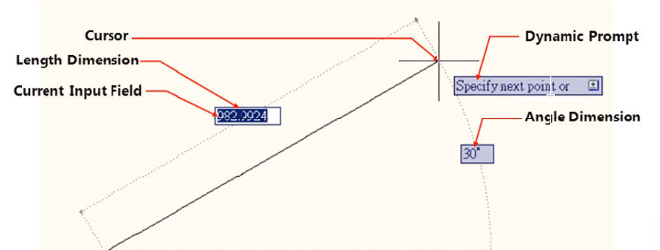
USER INTERFACE
Dynamic Input and the Command Window
• Dynamic input places a command interface beside the cursor as you draw.
• Tooltips show prompts, dimensions and coordinate entry at the crosshair.
• The command window (Ctrl+9) accepts commands and shows every prompt.
• Watch the prompts — AutoCAD always tells you what it expects next.
WSQ Technical Drawing with AutoCAD · TGS-2021005538
© 2026 Tertiary Infotech Academy Pte Ltd
26

Slide 27
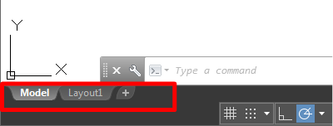
WORKSPACE
Model Space and Paper Space
• Model space is where you design — always draw at 1:1 real-world size.
• Paper space (layouts) is where you compose scaled sheets for printing.
• The UCS icon shows the origin and orientation of the coordinate system.
• Switch between them with the Model and Layout tabs below the drawing area.
WSQ Technical Drawing with AutoCAD · TGS-2021005538
© 2026 Tertiary Infotech Academy Pte Ltd
27

Slide 28
WORKSPACE
Workspaces and the Quick Access Toolbar
• Workspaces group menus, toolbars and ribbons for a task: Drafting & Annotation, 3D Basics, 3D Modeling.
• This course uses Drafting & Annotation throughout.
• The Quick Access Toolbar sits top-left: New, Open, Save, Undo, Plot.
• Right-click any ribbon tool → Add to Quick Access Toolbar to customise it.
WSQ Technical Drawing with AutoCAD · TGS-2021005538
© 2026 Tertiary Infotech Academy Pte Ltd
28

Slide 29

NAVIGATION
Navigation — Zoom, Pan and the Wheel Mouse
• The navigation bar provides Pan and the full set of Zoom tools.
• ZOOM (Z): Window, All, Extents, Previous, Scale, Object — know them all.
• Wheel mouse: scroll to zoom, press to pan, double-click to zoom extents.
• Navigation changes your view only — it never moves the geometry.
WSQ Technical Drawing with AutoCAD · TGS-2021005538
© 2026 Tertiary Infotech Academy Pte Ltd
29

Slide 30
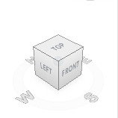
NAVIGATION
ViewCube and 2D/3D Views
• The ViewCube switches between standard and isometric views of the model.
• Click a face, edge or corner to jump to that view; drag to orbit freely.
• Set Current View as Home to return to a saved orientation.
• In 2D drafting you will mostly stay on the Top view.
WSQ Technical Drawing with AutoCAD · TGS-2021005538
© 2026 Tertiary Infotech Academy Pte Ltd
30

Slide 31
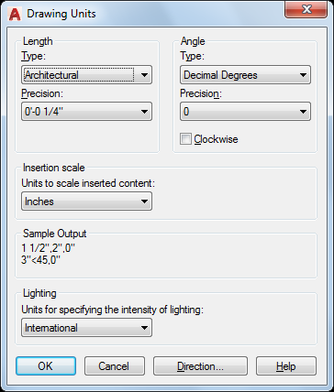
SETUP
Drawing Units and Converting Units
• UNITS sets the length type (Decimal, Architectural, Engineering…) and precision.
• Angles default to decimal degrees measured anticlockwise from east.
• This course draws in millimetres with decimal units.
• To convert a drawing's scale: SCALE → All → base 0,0 → factor (e.g. 25.4).
WSQ Technical Drawing with AutoCAD · TGS-2021005538
© 2026 Tertiary Infotech Academy Pte Ltd
31

Slide 32
TOPIC 01 · HANDS-ON
Setting Up a New Drawing
LAB 1
Create a new metric drawing from the ACADISO template, choose the Drafting & Annotation workspace, set units and limits, then open a finished drawing and practise reading it with the zoom, pan and ViewCube navigation tools.
You'll produce
A correctly configured metric drawing (units, limits, workspace) saved as DWG, plus confident navigation of an existing technical drawing.
Commands: ACADISO template, UNITS, LIMITS, ZOOM, PAN, ViewCube
Files: labs/lab-01-setting-up-a-new-drawing/lab01-table.dwg
WSQ Technical Drawing with AutoCAD · TGS-2021005538
© 2026 Tertiary Infotech Academy Pte Ltd
32

Slide 33
LAB 1 · STEP-BY-STEP
Setting Up a New Drawing
STEPS 1–3 OF 7
Start AutoCAD and create a new drawing from the ISO metric template
1
NEW → acadiso.dwt
Switch the workspace to Drafting & Annotation from the status bar gear icon
2
WSCURRENT → Drafting & Annotation
Set decimal length units with 0.00 precision and decimal degrees for angles
3
UNITS → Length: Decimal, Precision 0.00
WSQ Technical Drawing with AutoCAD · TGS-2021005538
© 2026 Tertiary Infotech Academy Pte Ltd
33

Slide 34
LAB 1 · STEP-BY-STEP
Setting Up a New Drawing
STEPS 4–6 OF 7
Frame an A3-sized working area with drawing limits, then zoom to it
4
LIMITS → 0,0 → 420,297 | ZOOM → All
Toggle the precision aids on the status bar: grid, snap, ortho, polar and object snap
5
F7 grid · F9 snap · F8 ortho · F10 polar · F3 osnap
Open lab01-table.dwg and navigate it: wheel-zoom, pan, zoom window and zoom extents
6
OPEN lab01-table.dwg → Z → W / Z → E
WSQ Technical Drawing with AutoCAD · TGS-2021005538
© 2026 Tertiary Infotech Academy Pte Ltd
34

Slide 35
LAB 1 · STEP-BY-STEP
Setting Up a New Drawing
STEPS 7–7 OF 7
Identify the views, dimensions and title information in the drawing, then save your setup file
7
SAVEAS → lab01-setup.dwg
WSQ Technical Drawing with AutoCAD · TGS-2021005538
© 2026 Tertiary Infotech Academy Pte Ltd
35

Slide 36
LAB 1 · VERIFY
Setting Up a New Drawing
✅ Check your work
You can state the drawing's units, limits and workspace; zoom to any detail of lab01-table.dwg and back to extents; and your lab01-setup.dwg opens with the settings intact.
WSQ Technical Drawing with AutoCAD · TGS-2021005538
© 2026 Tertiary Infotech Academy Pte Ltd
36

Slide 37
TOPIC RECAP
Recap — Getting Started with AutoCAD
Lab 1 — Setting Up a New Drawing
A correctly configured metric drawing (units, limits, workspace) saved as DWG, plus confident navigation of an existing technical drawing.
1
WSQ Technical Drawing with AutoCAD · TGS-2021005538
© 2026 Tertiary Infotech Academy Pte Ltd
37

Slide 38
02
TOPIC 02
Technical Drawing with AutoCAD
Basic AutoCAD Operations · Drawing Objects · Isometric Drawing
WSQ Technical Drawing with AutoCAD · TGS-2021005538
© 2026 Tertiary Infotech Academy Pte Ltd
38

Slide 39
SKILLS FRAMEWORK A2 · K2
Key Concepts — Technical Drawing with AutoCAD
Lines & polylines
LINE draws separate segments; PLINE creates one connected object of line and arc segments.
Circles & arcs
Circles by centre/radius or diameter; arcs by combinations of start, centre, end, radius and angle.
1
2
Rectangles & polygons
RECTANG builds closed rectangular polylines; POLYGON draws 3–1024-sided regular polygons.
Ellipses, splines & points
Ellipses from axis endpoints; splines as smooth curves through fit points; points as snap nodes.
3
4
Construction geometry
Construction lines (XLINE) and rays give infinite reference lines for projecting views.
2D isometric drawing
ISODRAFT turns on isometric planes so a flat drawing represents a 3D projection.
5
6
WSQ Technical Drawing with AutoCAD · TGS-2021005538
© 2026 Tertiary Infotech Academy Pte Ltd
39

Slide 40
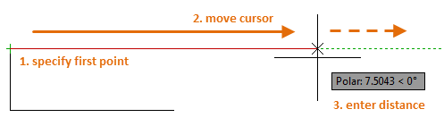
DRAWING OBJECTS
Lines
• LINE draws straight segments between picked or typed points.
• Specify the first point, then each next point; every segment is a separate object.
• Combine with object snaps and grid snap for exact geometry.
• Coordinate entry: absolute (100,50) · relative (@50,0) · polar (@50<30).
WSQ Technical Drawing with AutoCAD · TGS-2021005538
© 2026 Tertiary Infotech Academy Pte Ltd
40

Slide 41
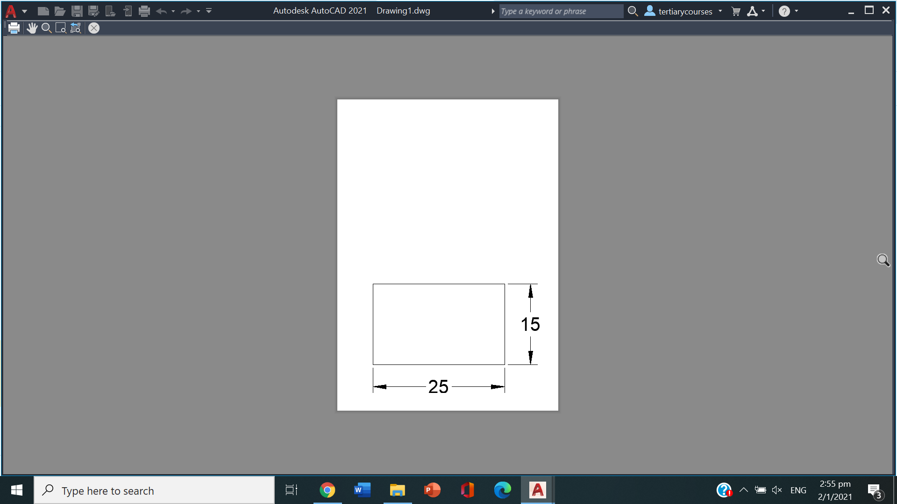
DRAWING OBJECTS
Circles and Rectangles
• CIRCLE: centre + radius or diameter; 2P/3P through points; TTR tangent-tangent-radius.
• RECTANG creates a closed rectangular polyline from two corners.
• Rectangle options add chamfered or filleted corners and a set width.
• Use dimensions option (@length,width) for exact rectangle sizes.
WSQ Technical Drawing with AutoCAD · TGS-2021005538
© 2026 Tertiary Infotech Academy Pte Ltd
41

Slide 42
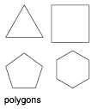
DRAWING OBJECTS
Polygons and Ellipses
• POLYGON draws regular polygons of 3–1024 sides.
• Inscribed polygons fit inside the reference circle; circumscribed fit outside.
• ELLIPSE uses two axis endpoints then the half-width of the other axis.
• An elliptical arc is an ellipse with start and end angles.
WSQ Technical Drawing with AutoCAD · TGS-2021005538
© 2026 Tertiary Infotech Academy Pte Ltd
42

Slide 43
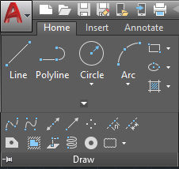
DRAWING OBJECTS
Arcs, Polylines and Splines
• ARC draws by combinations of start, centre, end, radius, angle and direction.
• PLINE creates one object of connected line and arc segments — switch modes as you draw.
• SPLINE fits a smooth curve through or near a set of fit points.
• Closed polylines are the basis for hatching, areas and 3D operations.
WSQ Technical Drawing with AutoCAD · TGS-2021005538
© 2026 Tertiary Infotech Academy Pte Ltd
43

Slide 44
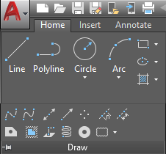
CONSTRUCTION GEOMETRY
Points, Construction Lines and Rays
• POINT places node objects; PDMODE and PDSIZE control how they display.
• Points act as snap nodes — DIVIDE and MEASURE place them along objects.
• XLINE creates infinite construction lines for projecting between views.
• RAY starts at a point and extends infinitely in one direction.
WSQ Technical Drawing with AutoCAD · TGS-2021005538
© 2026 Tertiary Infotech Academy Pte Ltd
44

Slide 45
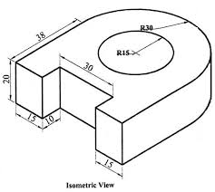
ISOMETRIC
2D Isometric Drawing with ISODRAFT
• A 2D isometric drawing is a flat representation of a 3D isometric projection.
• ISODRAFT switches the crosshairs to the isometric axes (30°/90°/150°).
• F5 cycles the three isoplanes: Top, Right and Left.
• Isocircles (ELLIPSE → Isocircle) draw round features on the active isoplane.
WSQ Technical Drawing with AutoCAD · TGS-2021005538
© 2026 Tertiary Infotech Academy Pte Ltd
45

Slide 46
WHAT YOU'LL DO
Hands-On Labs — Technical Drawing with AutoCAD
Labs 2–3
Labs 4–5
—
• Creating Lines and Coordinates
• Circles, Rectangles and Polygons
• Polylines, Arcs, Ellipses and Splines
• 2D Isometric Drawing
• —
WSQ Technical Drawing with AutoCAD · TGS-2021005538
© 2026 Tertiary Infotech Academy Pte Ltd
46

Slide 47
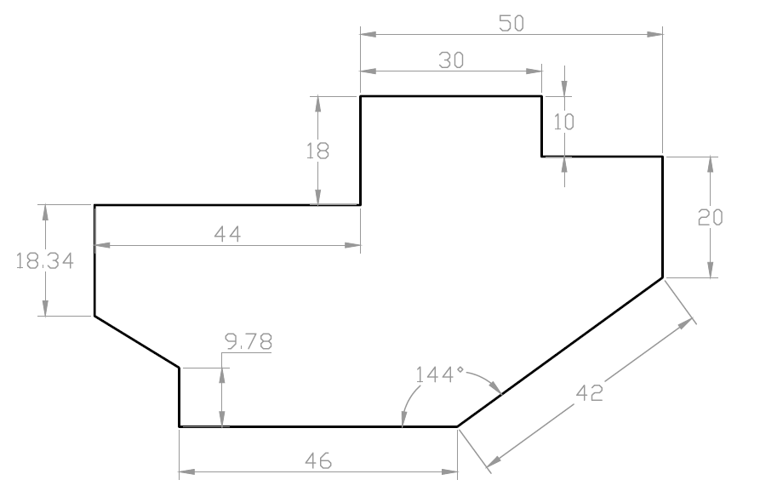
TOPIC 02 · HANDS-ON
Creating Lines and Coordinates
LAB 2
Draw the outline of practice drawing EX-1 using the LINE and PLINE commands with absolute, relative and polar coordinate entry, working from its dimensioned drawing sheet.
You'll produce
The completed EX-1 profile drawn to size, matching the supplied solution DWG.
Commands: LINE, PLINE, coordinate entry (@dx,dy · @dist<angle), ORTHO, dynamic input
Files: labs/lab-02-creating-lines-and-coordinates/ex1.dwg
WSQ Technical Drawing with AutoCAD · TGS-2021005538
© 2026 Tertiary Infotech Academy Pte Ltd
47

Slide 48
LAB 2 · STEP-BY-STEP
Creating Lines and Coordinates
STEPS 1–3 OF 6
Open the EX-1 drawing sheet (ex1-drawing-sheet.pdf) and study the dimensions
1
Start a new acadiso drawing and draw the first edge with absolute coordinates
2
L → 0,0 → 100,0
Continue the profile with relative coordinates for each dimensioned edge
3
@0,50 · @-30,0 · @20<135
WSQ Technical Drawing with AutoCAD · TGS-2021005538
© 2026 Tertiary Infotech Academy Pte Ltd
48

Slide 49
LAB 2 · STEP-BY-STEP
Creating Lines and Coordinates
STEPS 4–6 OF 6
Use ortho (F8) and polar tracking (F10) for the horizontal and vertical segments
4
F8 · F10
Close the profile back to the start point and check it forms one closed loop
5
C (Close)
Compare your result against the solution file ex1.dwg, then save
6
OPEN ex1.dwg → SAVEAS ex1-mine.dwg
WSQ Technical Drawing with AutoCAD · TGS-2021005538
© 2026 Tertiary Infotech Academy Pte Ltd
49

Slide 50
LAB 2 · VERIFY
Creating Lines and Coordinates
✅ Check your work
Your outline closes exactly (LIST shows the final vertex at 0,0) and overlays the solution ex1.dwg with no visible deviation.
WSQ Technical Drawing with AutoCAD · TGS-2021005538
© 2026 Tertiary Infotech Academy Pte Ltd
50

Slide 51
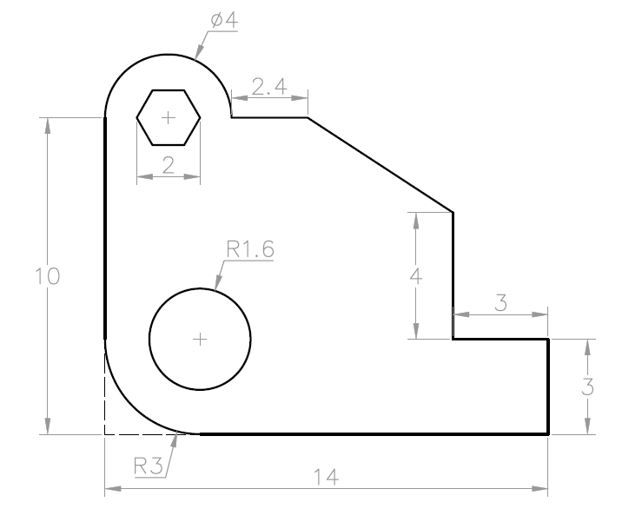
TOPIC 02 · HANDS-ON
Circles, Rectangles and Polygons
LAB 3
Complete practice drawing EX-2 by adding circles (centre-radius, diameter, 2P/3P and Tan-Tan-Radius), a rectangle with chamfered/filleted corners and inscribed/circumscribed polygons.
You'll produce
The completed EX-2 drawing with all holes, rectangles and polygons placed to the sheet dimensions.
Commands: CIRCLE (Cen-Rad, 2P, 3P, TTR), RECTANG, POLYGON, object snaps
Files: labs/lab-03-circles-rectangles-and-polygons/ex2.dwg
WSQ Technical Drawing with AutoCAD · TGS-2021005538
© 2026 Tertiary Infotech Academy Pte Ltd
51

Slide 52
LAB 3 · STEP-BY-STEP
Circles, Rectangles and Polygons
STEPS 1–3 OF 6
Open the EX-2 sheet (ex2-drawing-sheet.pdf) and identify each hole's centre
1
Draw the main circles by centre point and radius, snapping to intersections
2
C → cen point → 25
Add a circle by diameter and one through two points on existing geometry
3
C → D → 40 · C → 2P
WSQ Technical Drawing with AutoCAD · TGS-2021005538
© 2026 Tertiary Infotech Academy Pte Ltd
52

Slide 53
LAB 3 · STEP-BY-STEP
Circles, Rectangles and Polygons
STEPS 4–6 OF 6
Draw a tangent-tangent-radius circle touching two existing circles
4
C → TTR → pick 2 tangents → radius
Create the rectangle feature, then a hexagon inscribed in a 30-radius circle
5
REC → corner → @80,50 · POL → 6 → I → 30
Verify against the solution ex2.dwg and save your drawing
6
SAVEAS ex2-mine.dwg
WSQ Technical Drawing with AutoCAD · TGS-2021005538
© 2026 Tertiary Infotech Academy Pte Ltd
53

Slide 54
LAB 3 · VERIFY
Circles, Rectangles and Polygons
✅ Check your work
Every circle's centre and radius match the sheet (use LIST), the hexagon has 6 equal sides, and your drawing overlays ex2.dwg cleanly.
WSQ Technical Drawing with AutoCAD · TGS-2021005538
© 2026 Tertiary Infotech Academy Pte Ltd
54

Slide 55
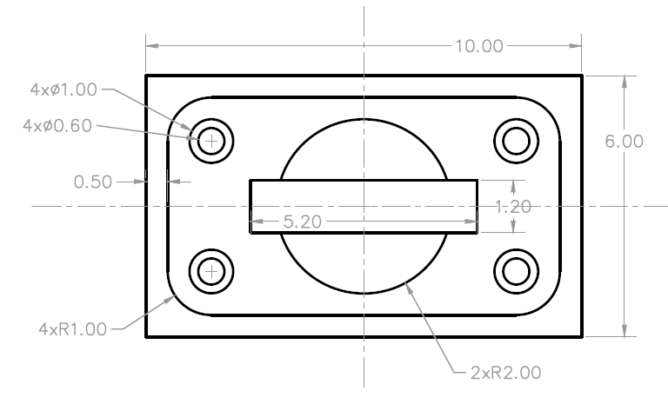
TOPIC 02 · HANDS-ON
Polylines, Arcs, Ellipses and Splines
LAB 4
Draw practice drawing EX-3 combining polylines with arc segments, standalone arcs, an ellipse and a spline, plus construction lines to project feature positions between views.
You'll produce
The completed EX-3 drawing with mixed line/arc geometry drawn as clean, connected objects.
Commands: PLINE (Arc mode), ARC, ELLIPSE, SPLINE, XLINE, POINT/DIVIDE
Files: labs/lab-04-polylines-arcs-ellipses-and-splines/ex3.dwg
WSQ Technical Drawing with AutoCAD · TGS-2021005538
© 2026 Tertiary Infotech Academy Pte Ltd
55

Slide 56
LAB 4 · STEP-BY-STEP
Polylines, Arcs, Ellipses and Splines
STEPS 1–3 OF 6
Open the EX-3 sheet (ex3-drawing-sheet.pdf) and plan the outline as one polyline
1
Draw the outline with PLINE, switching between Line and Arc segments as you go
2
PL → pick → A (arc) → L (line)
Place construction lines to project the centres of features between views
3
XL → H / V through centres
WSQ Technical Drawing with AutoCAD · TGS-2021005538
© 2026 Tertiary Infotech Academy Pte Ltd
56

Slide 57
LAB 4 · STEP-BY-STEP
Polylines, Arcs, Ellipses and Splines
STEPS 4–6 OF 6
Add a three-point arc and a centre-start-end arc where the sheet shows open curves
4
A → 3 points · A → C
Draw the ellipse from its axis endpoints and a smooth spline through the fit points
5
EL → axis ends → half-width · SPL
Compare with ex3.dwg, purge the construction lines and save
6
ERASE xlines → SAVEAS ex3-mine.dwg
WSQ Technical Drawing with AutoCAD · TGS-2021005538
© 2026 Tertiary Infotech Academy Pte Ltd
57

Slide 58
LAB 4 · VERIFY
Polylines, Arcs, Ellipses and Splines
✅ Check your work
The outline is a single polyline (one object when selected), arcs and the ellipse match the sheet dimensions, and no construction lines remain in the final drawing.
WSQ Technical Drawing with AutoCAD · TGS-2021005538
© 2026 Tertiary Infotech Academy Pte Ltd
58

Slide 59
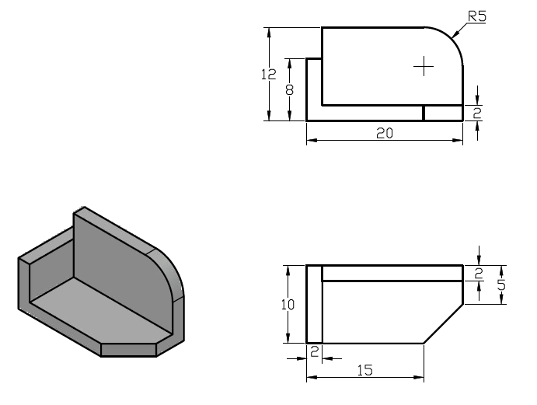
TOPIC 02 · HANDS-ON
2D Isometric Drawing
LAB 5
Use ISODRAFT to create a 2D isometric representation of the 3D object supplied in iso-object.dwg, switching isoplanes and drawing isocircles for the round features.
You'll produce
A flat isometric drawing of the 3D object — edges on the three isoplanes plus isocircle holes.
Commands: ISODRAFT, isoplanes (F5), ELLIPSE Isocircle, polar tracking
Files: labs/lab-05-2d-isometric-drawing/iso-object.dwg
WSQ Technical Drawing with AutoCAD · TGS-2021005538
© 2026 Tertiary Infotech Academy Pte Ltd
59

Slide 60
LAB 5 · STEP-BY-STEP
2D Isometric Drawing
STEPS 1–3 OF 6
Open the object sheet iso-object-sheet.pdf and identify its three faces
1
Turn on isometric drafting from the status bar and set the Top isoplane
2
ISODRAFT → Isoplane Top (F5)
Draw the top face edges along the 30°/150° isometric axes with polar tracking
3
L with polar 30°/150°
WSQ Technical Drawing with AutoCAD · TGS-2021005538
© 2026 Tertiary Infotech Academy Pte Ltd
60

Slide 61
LAB 5 · STEP-BY-STEP
2D Isometric Drawing
STEPS 4–6 OF 6
Switch to the Right and Left isoplanes and complete the vertical faces
4
F5 → Right · F5 → Left
Add the round features as isocircles on the correct isoplane
5
EL → I (Isocircle) → centre → radius
Compare your isometric with the 3D model in iso-object.dwg and save
6
SAVEAS iso-mine.dwg
WSQ Technical Drawing with AutoCAD · TGS-2021005538
© 2026 Tertiary Infotech Academy Pte Ltd
61

Slide 62
LAB 5 · VERIFY
2D Isometric Drawing
✅ Check your work
Each face lies on the correct isoplane (edges at 30°/90°/150°), the isocircles read as ellipses aligned to their faces, and the drawing matches the supplied object's proportions.
WSQ Technical Drawing with AutoCAD · TGS-2021005538
© 2026 Tertiary Infotech Academy Pte Ltd
62

Slide 63
TOPIC RECAP
Recap — Technical Drawing with AutoCAD
Lab 2 — Creating Lines and Coordinates
The completed EX-1 profile drawn to size, matching the supplied solution DWG.
Lab 3 — Circles, Rectangles and Polygons
The completed EX-2 drawing with all holes, rectangles and polygons placed to the sheet dimensions.
1
2
Lab 4 — Polylines, Arcs, Ellipses and Splines
The completed EX-3 drawing with mixed line/arc geometry drawn as clean, connected objects.
Lab 5 — 2D Isometric Drawing
A flat isometric drawing of the 3D object — edges on the three isoplanes plus isocircle holes.
3
4
WSQ Technical Drawing with AutoCAD · TGS-2021005538
© 2026 Tertiary Infotech Academy Pte Ltd
63

Slide 64
03
TOPIC 03
Modifying Objects
Move · Copy · Rotate · Offset · Mirror · Trim · Fillet · Arrays
WSQ Technical Drawing with AutoCAD · TGS-2021005538
© 2026 Tertiary Infotech Academy Pte Ltd
64

Slide 65
SKILLS FRAMEWORK A3 · K3
Key Concepts — Modifying Objects
Relocate & duplicate
MOVE, COPY and ROTATE reposition objects from a base point to a second point or angle.
Offset & mirror
OFFSET creates parallel copies at a set distance; MIRROR reflects half a symmetric design.
1
2
Trim & extend
Quick and Standard modes cut objects back to, or extend them to meet, boundary edges.
Fillet & chamfer
FILLET rounds a corner with a radius; CHAMFER bevels it with distances or an angle.
3
4
Arrays
Rectangular, polar and path arrays distribute copies in rows/columns, around a centre, or along a curve.
Stretch, scale & explode
STRETCH lengthens with a crossing window; SCALE resizes about a base point; EXPLODE breaks compounds.
5
6
WSQ Technical Drawing with AutoCAD · TGS-2021005538
© 2026 Tertiary Infotech Academy Pte Ltd
65

Slide 66
MODIFY
Relocating and Duplicating Objects
MOVE (M)
Select objects, pick a base point, then the second point — the objects relocate exactly.
COPY (CO)
Same flow as MOVE but leaves the original; Multiple mode places copy after copy.
1
2
ROTATE (RO)
Rotate about a base point by an absolute angle, or use Reference to match geometry.
OFFSET (O)
Creates concentric circles, parallel lines and parallel curves at a set distance.
3
4
WSQ Technical Drawing with AutoCAD · TGS-2021005538
© 2026 Tertiary Infotech Academy Pte Ltd
66

Slide 67
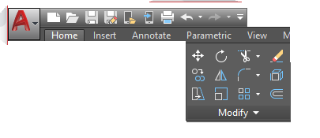
MODIFY
Offset in Practice
• Specify the offset distance, select the object, then click the side to offset to.
• Through mode offsets through a picked point instead of a distance.
• Offset polylines keep their corners; circles offset concentrically.
• Wall outlines, slots and rims are all one offset away from their centreline.
WSQ Technical Drawing with AutoCAD · TGS-2021005538
© 2026 Tertiary Infotech Academy Pte Ltd
67

Slide 68
MODIFY
Mirror, Stretch and Scale
MIRROR (MI)
Draw half of a symmetric design, then reflect it across a two-point mirror line.
STRETCH (S)
Select with a crossing window; endpoints inside move, the rest stay anchored.
1
2
SCALE (SC)
Resize about a base point by factor — or Reference to hit an exact length.
Grips
Select first, then drag grips to stretch/move without any command.
3
4
WSQ Technical Drawing with AutoCAD · TGS-2021005538
© 2026 Tertiary Infotech Academy Pte Ltd
68

Slide 69
MODIFY
Trim and Extend — Two Modes
Quick mode (default)
Standard mode
• Select the objects to be trimmed or extended, one by one or by dragging
• All visible geometry acts as the cutting/boundary edge
• Fastest for everyday cleanup
• First select boundary edges, press Enter, then select objects to trim/extend
• Press Enter at the first prompt to make everything a boundary
• Precise control for crowded drawings
WSQ Technical Drawing with AutoCAD · TGS-2021005538
© 2026 Tertiary Infotech Academy Pte Ltd
69

Slide 70
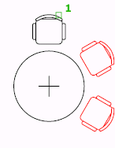
MODIFY
Arrays — Rectangular, Polar and Path
• ARRAY creates copies arranged in a pattern — associative by default.
• Rectangular: rows, columns and levels with set spacing.
• Polar: evenly distributes copies around a centre point or axis.
• Path: distributes copies along a line, polyline or curve.
WSQ Technical Drawing with AutoCAD · TGS-2021005538
© 2026 Tertiary Infotech Academy Pte Ltd
70

Slide 71
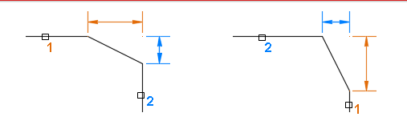
MODIFY
Fillet and Chamfer
• FILLET rounds the corner between two objects with a set radius.
• Enter r (Radius) first to change the current fillet radius.
• CHAMFER bevels a corner using two distances or a distance and angle.
• Radius 0 / distance 0 are quick ways to square off a corner exactly.
WSQ Technical Drawing with AutoCAD · TGS-2021005538
© 2026 Tertiary Infotech Academy Pte Ltd
71

Slide 72
MODIFY
Erase, Explode, Break, Divide and Measure
ERASE (E)
Remove selected objects — or select first and press Delete.
EXPLODE (X)
Break a compound object (polyline, block, array) into components.
1
2
BREAK / Break at Point
Split lines, open polylines and arcs at one or two points.
DIVIDE · MEASURE
Place point nodes at equal counts (DIVIDE) or set intervals (MEASURE).
3
4
WSQ Technical Drawing with AutoCAD · TGS-2021005538
© 2026 Tertiary Infotech Academy Pte Ltd
72

Slide 73
WHAT YOU'LL DO
Hands-On Labs — Modifying Objects
Lab 6
Lab 7
Lab 8
• Move, Copy, Rotate and Offset
• Trim, Extend, Fillet and Chamfer
• Mirror, Stretch, Scale and Arrays
WSQ Technical Drawing with AutoCAD · TGS-2021005538
© 2026 Tertiary Infotech Academy Pte Ltd
73

Slide 74
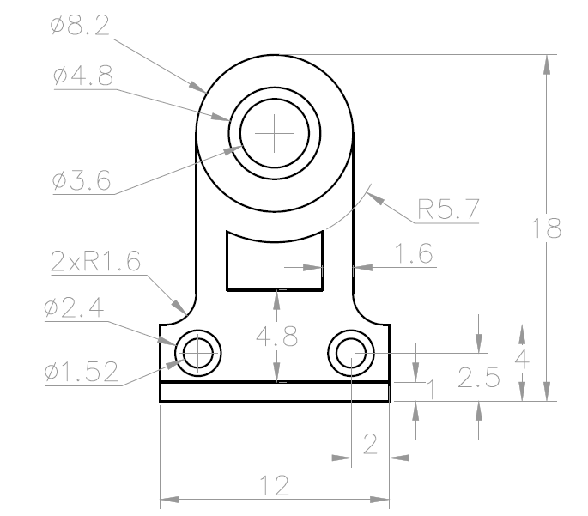
TOPIC 03 · HANDS-ON
Move, Copy, Rotate and Offset
LAB 6
Build practice drawing EX-4 by drawing one feature and then positioning the rest with MOVE, COPY (multiple), ROTATE with reference angle and OFFSET for the parallel profiles.
You'll produce
The completed EX-4 drawing produced with modify commands rather than re-drawing each feature.
Commands: MOVE, COPY (Multiple/Array), ROTATE (Reference), OFFSET
Files: labs/lab-06-move-copy-rotate-and-offset/ex4.dwg
WSQ Technical Drawing with AutoCAD · TGS-2021005538
© 2026 Tertiary Infotech Academy Pte Ltd
74

Slide 75
LAB 6 · STEP-BY-STEP
Move, Copy, Rotate and Offset
STEPS 1–3 OF 6
Open the EX-4 sheet (ex4-drawing-sheet.pdf) and spot the repeated features
1
Draw the base profile, then offset it to create the parallel inner/outer edges
2
O → distance → pick side
Draw one hole feature and copy it to every dimensioned centre
3
CO → base point → second points
WSQ Technical Drawing with AutoCAD · TGS-2021005538
© 2026 Tertiary Infotech Academy Pte Ltd
75

Slide 76
LAB 6 · STEP-BY-STEP
Move, Copy, Rotate and Offset
STEPS 4–6 OF 6
Move a mis-placed feature precisely from its centre to the correct intersection
4
M → base → destination
Rotate the angled feature about its base point, using Reference to match the sheet angle
5
RO → base → R → ref angle → new angle
Check against ex4.dwg and save your version
6
SAVEAS ex4-mine.dwg
WSQ Technical Drawing with AutoCAD · TGS-2021005538
© 2026 Tertiary Infotech Academy Pte Ltd
76

Slide 77
LAB 6 · VERIFY
Move, Copy, Rotate and Offset
✅ Check your work
Feature spacings measure correct with DIST, offsets are at the specified distances, and the rotated feature sits at exactly the sheet's angle.
WSQ Technical Drawing with AutoCAD · TGS-2021005538
© 2026 Tertiary Infotech Academy Pte Ltd
77

Slide 78
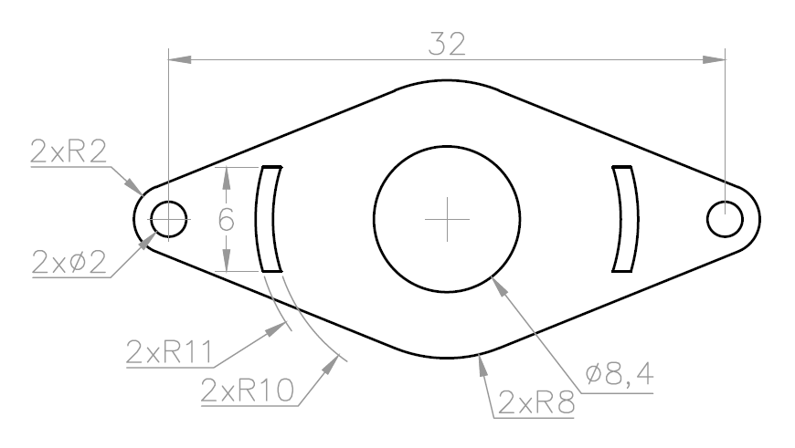
TOPIC 03 · HANDS-ON
Trim, Extend, Fillet and Chamfer
LAB 7
Complete practice drawing EX-5 by trimming overlapping construction geometry, extending short edges to their boundaries, and finishing corners with fillets and chamfers.
You'll produce
A clean EX-5 profile with every corner finished exactly as dimensioned on the sheet.
Commands: TRIM (Quick/Standard), EXTEND, FILLET, CHAMFER, BREAK
Files: labs/lab-07-trim-extend-fillet-and-chamfer/ex5.dwg
WSQ Technical Drawing with AutoCAD · TGS-2021005538
© 2026 Tertiary Infotech Academy Pte Ltd
78

Slide 79
LAB 7 · STEP-BY-STEP
Trim, Extend, Fillet and Chamfer
STEPS 1–3 OF 6
Open the EX-5 sheet (ex5-drawing-sheet.pdf) and rough out the profile with overlapping lines
1
Trim the overshoots in Quick mode — click or drag across the pieces to remove
2
TR → click segments
Use Standard mode where you need explicit cutting edges: select boundaries, then objects
3
TR → Enter (all edges) → pick
WSQ Technical Drawing with AutoCAD · TGS-2021005538
© 2026 Tertiary Infotech Academy Pte Ltd
79

Slide 80
LAB 7 · STEP-BY-STEP
Trim, Extend, Fillet and Chamfer
STEPS 4–6 OF 6
Extend the short edges to meet their boundary lines
4
EX → pick edges to extend
Fillet the rounded corners at the sheet radius, and chamfer the bevelled ones
5
F → R → 10 → pick 2 lines · CHA → D → 5,5
Compare with ex5.dwg and save
6
SAVEAS ex5-mine.dwg
WSQ Technical Drawing with AutoCAD · TGS-2021005538
© 2026 Tertiary Infotech Academy Pte Ltd
80

Slide 81
LAB 7 · VERIFY
Trim, Extend, Fillet and Chamfer
✅ Check your work
No overshooting or dangling segments remain (zoom around the whole profile), and every fillet radius / chamfer distance matches the drawing sheet.
WSQ Technical Drawing with AutoCAD · TGS-2021005538
© 2026 Tertiary Infotech Academy Pte Ltd
81

Slide 82
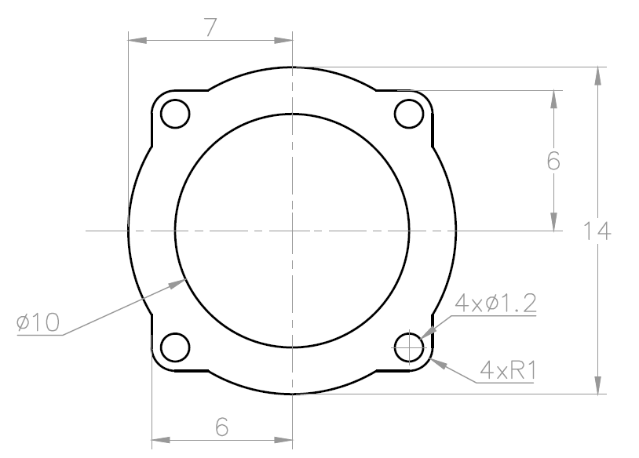
TOPIC 03 · HANDS-ON
Mirror, Stretch, Scale and Arrays
LAB 8
Produce practice drawing EX-6 by drawing half of the symmetric design and mirroring it, then distributing the hole pattern with rectangular and polar arrays, and adjusting sizes with STRETCH and SCALE.
You'll produce
The completed EX-6 drawing with its symmetric outline and evenly arrayed hole pattern.
Commands: MIRROR, STRETCH (crossing window), SCALE (Reference), ARRAYRECT, ARRAYPOLAR
Files: labs/lab-08-mirror-stretch-scale-and-arrays/ex6.dwg
WSQ Technical Drawing with AutoCAD · TGS-2021005538
© 2026 Tertiary Infotech Academy Pte Ltd
82

Slide 83
LAB 8 · STEP-BY-STEP
Mirror, Stretch, Scale and Arrays
STEPS 1–3 OF 6
Open the EX-6 sheet (ex6-drawing-sheet.pdf) and find its axis of symmetry
1
Draw one half of the outline, then mirror it across the centreline
2
MI → select → axis pt1 → pt2 → N
Array one hole into the rectangular pattern (rows, columns, spacing from the sheet)
3
AR → R → rows/cols/spacing
WSQ Technical Drawing with AutoCAD · TGS-2021005538
© 2026 Tertiary Infotech Academy Pte Ltd
83

Slide 84
LAB 8 · STEP-BY-STEP
Mirror, Stretch, Scale and Arrays
STEPS 4–6 OF 6
Distribute the bolt holes around the centre with a polar array
4
AR → PO → centre → items → 360
Stretch the slot to its dimensioned length with a crossing window, scale a feature with Reference
5
S → crossing → base → distance · SC → R
Verify against ex6.dwg and save
6
SAVEAS ex6-mine.dwg
WSQ Technical Drawing with AutoCAD · TGS-2021005538
© 2026 Tertiary Infotech Academy Pte Ltd
84

Slide 85
LAB 8 · VERIFY
Mirror, Stretch, Scale and Arrays
✅ Check your work
The two halves are perfectly symmetric about the centreline, array counts and spacings match the sheet, and the stretched slot measures the dimensioned length.
WSQ Technical Drawing with AutoCAD · TGS-2021005538
© 2026 Tertiary Infotech Academy Pte Ltd
85

Slide 86
TOPIC RECAP
Recap — Modifying Objects
Lab 6 — Move, Copy, Rotate and Offset
The completed EX-4 drawing produced with modify commands rather than re-drawing each feature.
1
Lab 7 — Trim, Extend, Fillet and Chamfer
A clean EX-5 profile with every corner finished exactly as dimensioned on the sheet.
2
Lab 8 — Mirror, Stretch, Scale and Arrays
The completed EX-6 drawing with its symmetric outline and evenly arrayed hole pattern.
3
WSQ Technical Drawing with AutoCAD · TGS-2021005538
© 2026 Tertiary Infotech Academy Pte Ltd
86

Slide 87
04
TOPIC 04
Organizing Objects
Object Properties · Layers · Blocks, Attributes & Reusable Content
WSQ Technical Drawing with AutoCAD · TGS-2021005538
© 2026 Tertiary Infotech Academy Pte Ltd
87

Slide 88
SKILLS FRAMEWORK A4 · K4
Key Concepts — Organizing Objects
Object properties
Colour, linetype and lineweight — set ByLayer and inspected in the Properties palette (PR).
Layers
The primary method of organising a drawing by function; control on/off, freeze/thaw, lock and plot.
1
2
Grips
Multi-functional grips stretch, move, rotate, scale and copy objects without typing a command.
Hide & isolate
Temporarily isolate the objects you are working on and hide the rest of the drawing.
3
4
Blocks & attributes
Blocks are reusable symbols; attributes attach part numbers and data — the basis of part lists.
External references
Xrefs attach another drawing (or PDF underlay) so teams share one live reference file.
5
6
WSQ Technical Drawing with AutoCAD · TGS-2021005538
© 2026 Tertiary Infotech Academy Pte Ltd
88

Slide 89
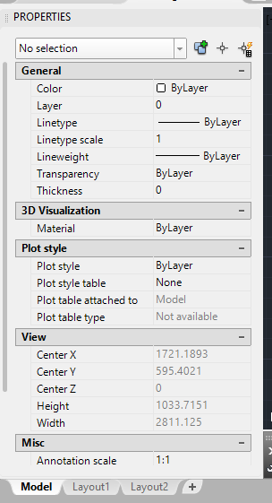
PROPERTIES
Object Properties and the Properties Palette
• The Home tab's Layers and Properties panels set the most common properties.
• The Properties palette (PR / Ctrl+1) is the complete list for any selection.
• With nothing selected it shows — and sets — the current defaults.
• Keep colour, linetype and lineweight ByLayer so layers stay in control.
WSQ Technical Drawing with AutoCAD · TGS-2021005538
© 2026 Tertiary Infotech Academy Pte Ltd
89

Slide 90
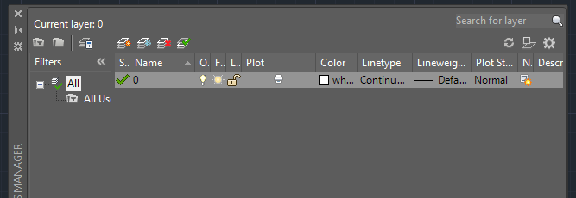
LAYERS
Layers — Organising Every Drawing
• Layers organise objects by function: outlines, hidden lines, centrelines, text, dimensions.
• The Layer Properties Manager creates layers and sets colour, linetype, lineweight and plot.
• All new objects are drawn on the current layer (green tick).
• Off vs freeze: frozen layers are skipped entirely and speed up big drawings; lock to view but not edit.
WSQ Technical Drawing with AutoCAD · TGS-2021005538
© 2026 Tertiary Infotech Academy Pte Ltd
90

Slide 91
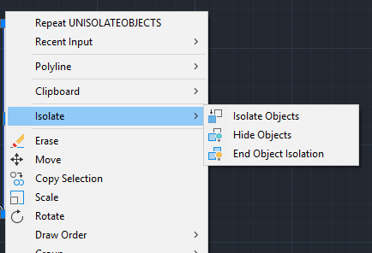
FOCUS
Hide and Isolate Objects
• Isolate Selected Objects hides everything except your selection.
• Hide Selected Objects removes just the selection from view.
• Both are temporary view states — End Object Isolation restores all.
• Right-click menu or the status-bar lightbulb icon controls isolation.
WSQ Technical Drawing with AutoCAD · TGS-2021005538
© 2026 Tertiary Infotech Academy Pte Ltd
91

Slide 92
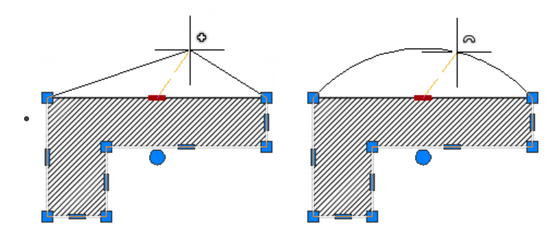
DIRECT EDITING
Multi-Functional Grips
• Select with no command running and grips appear at defining points.
• Drag a grip to stretch; press Enter to cycle Stretch → Move → Rotate → Scale → Mirror.
• Hover a grip for its multi-function menu (e.g. add vertex, convert to arc).
• Lines, polylines, arcs, dimensions and viewports all expose smart grips.
WSQ Technical Drawing with AutoCAD · TGS-2021005538
© 2026 Tertiary Infotech Academy Pte Ltd
92

Slide 93
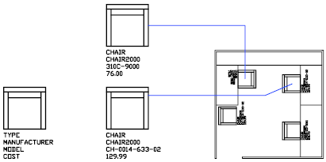
REUSABLE CONTENT
Blocks, Dynamic Blocks and Attributes
• BLOCK combines objects into a named, reusable symbol inserted with INSERT.
• Dynamic blocks add parameters and actions — one block, many sizes/states.
• Attributes attach data to a block: part numbers, descriptions, quantities.
• ATTDEF defines the tag, prompt and default; DATAEXTRACTION turns attributes into part-list tables.
WSQ Technical Drawing with AutoCAD · TGS-2021005538
© 2026 Tertiary Infotech Academy Pte Ltd
93

Slide 94
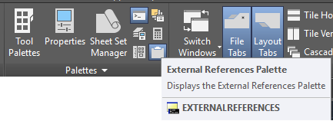
REUSABLE CONTENT
External References (Xrefs)
• An xref attaches another drawing file into the current drawing — live, not copied.
• The External References palette organises, reloads and repaths every reference.
• Teams share one title block or site plan; edits flow to every host on reload.
• PDFs and images attach the same way as underlays for tracing.
WSQ Technical Drawing with AutoCAD · TGS-2021005538
© 2026 Tertiary Infotech Academy Pte Ltd
94

Slide 95
WHAT YOU'LL DO
Hands-On Labs — Organizing Objects
Labs 9–10
Labs 11–12
—
• Object Properties and Layers
• Grips, Hide and Isolate
• Blocks, Attributes and Part Lists
• External References and PDF Import
• —
WSQ Technical Drawing with AutoCAD · TGS-2021005538
© 2026 Tertiary Infotech Academy Pte Ltd
95

Slide 96
TOPIC 04 · HANDS-ON
Object Properties and Layers
LAB 9
Open the furniture drawing lab-table-lesson2.dwg, create a layer scheme (outline, hidden, centre, dimensions, text), assign colours/linetypes/lineweights ByLayer, and move the existing objects onto the correct layers.
You'll produce
A layered version of the table drawing where every object's colour and linetype come ByLayer.
Commands: LAYER (LA), Properties palette (PR), Layer Walk, MATCHPROP, freeze/thaw, lock
Files: labs/lab-09-object-properties-and-layers/lab-table-lesson2.dwg
WSQ Technical Drawing with AutoCAD · TGS-2021005538
© 2026 Tertiary Infotech Academy Pte Ltd
96

Slide 97
LAB 9 · STEP-BY-STEP
Object Properties and Layers
STEPS 1–3 OF 6
Open lab-table-lesson2.dwg and inspect current object properties
1
PR (Properties palette)
Create layers: A-OUTLINE, A-HIDDEN, A-CENTRE, A-DIMS, A-TEXT with colours and linetypes
2
LA → New Layer → colour/linetype
Load the HIDDEN and CENTER linetypes and set lineweights per layer
3
LA → Linetype → Load → HIDDEN, CENTER
WSQ Technical Drawing with AutoCAD · TGS-2021005538
© 2026 Tertiary Infotech Academy Pte Ltd
97

Slide 98
LAB 9 · STEP-BY-STEP
Object Properties and Layers
STEPS 4–6 OF 6
Select objects by type and move them to their layers; copy formatting with MATCHPROP
4
select → Layer drop-down · MA
Practise layer states: turn off, freeze/thaw, lock and Layer Walk through the scheme
5
LAYWALK · LAYFRZ · LAYLCK
Set every object's colour, linetype and lineweight to ByLayer and save
6
SETBYLAYER → SAVEAS table-layers.dwg
WSQ Technical Drawing with AutoCAD · TGS-2021005538
© 2026 Tertiary Infotech Academy Pte Ltd
98

Slide 99
LAB 9 · VERIFY
Object Properties and Layers
✅ Check your work
Turning each layer off hides exactly its objects, everything reports ByLayer in the Properties palette, and Layer Walk steps cleanly through the scheme.
WSQ Technical Drawing with AutoCAD · TGS-2021005538
© 2026 Tertiary Infotech Academy Pte Ltd
99

Slide 100
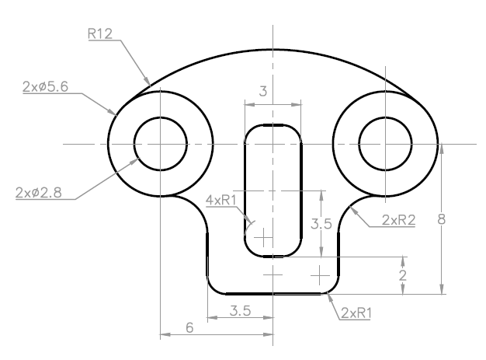
TOPIC 04 · HANDS-ON
Grips, Hide and Isolate
LAB 10
Use multi-functional grips on practice drawing EX-7 to stretch, move, copy and rotate features without commands, and manage a busy view with Isolate and Hide Selected Objects.
You'll produce
An edited EX-7 layout adjusted entirely with grips, plus fluent use of isolate/hide/end-isolate.
Commands: Multi-functional grips, grip modes (Enter to cycle), Isolate/Hide Objects, Select Similar
Files: labs/lab-10-grips-hide-and-isolate/ex7.dwg
WSQ Technical Drawing with AutoCAD · TGS-2021005538
© 2026 Tertiary Infotech Academy Pte Ltd
100

Slide 101
LAB 10 · STEP-BY-STEP
Grips, Hide and Isolate
STEPS 1–3 OF 6
Open ex7.dwg, click an object and hover its grips to see the grip menu
1
Stretch an endpoint grip to lengthen an edge; use the midpoint grip to move the object
2
click grip → drag / type distance
Cycle grip modes with Enter: Stretch → Move → Rotate → Scale → Mirror
3
select grip → Enter to cycle
WSQ Technical Drawing with AutoCAD · TGS-2021005538
© 2026 Tertiary Infotech Academy Pte Ltd
101

Slide 102
LAB 10 · STEP-BY-STEP
Grips, Hide and Isolate
STEPS 4–6 OF 6
Copy a feature by grip-moving with the Copy option (or Ctrl held)
4
grip → Move → C (Copy)
Right-click a feature: Isolate Objects → Isolate Selected, edit it, then End Isolation
5
ISOLATEOBJECTS · UNISOLATEOBJECTS
Use Select Similar to grab all matching objects and hide them temporarily
6
select → right-click → Select Similar → Hide
WSQ Technical Drawing with AutoCAD · TGS-2021005538
© 2026 Tertiary Infotech Academy Pte Ltd
102

Slide 103
LAB 10 · VERIFY
Grips, Hide and Isolate
✅ Check your work
You can stretch/move/rotate/copy with grips alone (no typed commands), and isolate then restore any subset of the drawing without losing objects.
WSQ Technical Drawing with AutoCAD · TGS-2021005538
© 2026 Tertiary Infotech Academy Pte Ltd
103

Slide 104
TOPIC 04 · HANDS-ON
Blocks, Attributes and Part Lists
LAB 11
Define a reusable part-tag block with attributes (part number, description, quantity) in the title-block drawing, insert it against each component, and prepare the attribute data that will feed the part list.
You'll produce
A BALLOON block with PART_NO / DESC / QTY attributes, inserted and filled in for each part.
Commands: BLOCK, ATTDEF, INSERT, ATTEDIT, groups, DATAEXTRACTION (preview)
Files: labs/lab-11-blocks-attributes-and-part-lists/title-block.dwg
WSQ Technical Drawing with AutoCAD · TGS-2021005538
© 2026 Tertiary Infotech Academy Pte Ltd
104

Slide 105
LAB 11 · STEP-BY-STEP
Blocks, Attributes and Part Lists
STEPS 1–3 OF 6
Open title-block.dwg and draw the balloon symbol (circle + leader stub)
1
C → radius 5
Define attributes PART_NO, DESC and QTY with prompts and default values
2
ATTDEF → tag/prompt/default
Create the block BALLOON from the circle plus its attribute definitions
3
B → name BALLOON → select objects
WSQ Technical Drawing with AutoCAD · TGS-2021005538
© 2026 Tertiary Infotech Academy Pte Ltd
105

Slide 106
LAB 11 · STEP-BY-STEP
Blocks, Attributes and Part Lists
STEPS 4–6 OF 6
Insert the balloon against each component and fill in the attribute values
4
I → BALLOON → answer prompts
Double-click a balloon to edit its attributes; group related parts together
5
ATTEDIT / EATTEDIT · GROUP
Preview extracting the attribute data — this becomes the part list in Lab 14
6
DATAEXTRACTION
WSQ Technical Drawing with AutoCAD · TGS-2021005538
© 2026 Tertiary Infotech Academy Pte Ltd
106

Slide 107
LAB 11 · VERIFY
Blocks, Attributes and Part Lists
✅ Check your work
Each inserted balloon prompts for and displays its own part number, description and quantity, and Data Extraction lists one row per balloon with the values you entered.
WSQ Technical Drawing with AutoCAD · TGS-2021005538
© 2026 Tertiary Infotech Academy Pte Ltd
107

Slide 108
TOPIC 04 · HANDS-ON
External References and PDF Import
LAB 12
Attach the title-block drawing as an external reference under the table drawing, observe how xref updates flow through, then attach a PDF as an underlay and import PDF geometry.
You'll produce
A host drawing with a live xref title block and a PDF underlay ready for tracing.
Commands: XREF/ATTACH, External References palette, PDFATTACH, PDFIMPORT
Files: labs/lab-12-external-references-and-pdf-import/title-block.dwg
WSQ Technical Drawing with AutoCAD · TGS-2021005538
© 2026 Tertiary Infotech Academy Pte Ltd
108

Slide 109
LAB 12 · STEP-BY-STEP
External References and PDF Import
STEPS 1–3 OF 6
Open your layered table drawing from Lab 9 as the host drawing
1
OPEN table-layers.dwg
Attach title-block.dwg as an Xref at 0,0, scale 1
2
XATTACH → title-block.dwg
Open the External References palette and note the xref's status and path
3
XR (External References)
WSQ Technical Drawing with AutoCAD · TGS-2021005538
© 2026 Tertiary Infotech Academy Pte Ltd
109

Slide 110
LAB 12 · STEP-BY-STEP
External References and PDF Import
STEPS 4–6 OF 6
Edit the title block in its own file, save, and reload the xref in the host
4
XR → right-click → Reload
Attach the supplied drawing-sheet PDF as an underlay and snap to its geometry
5
PDFATTACH → ex1-drawing-sheet.pdf
Import the PDF's vector geometry into the drawing and inspect the created objects
6
PDFIMPORT → select underlay area
WSQ Technical Drawing with AutoCAD · TGS-2021005538
© 2026 Tertiary Infotech Academy Pte Ltd
110

Slide 111
LAB 12 · VERIFY
External References and PDF Import
✅ Check your work
Changing the title block file and reloading updates the host without copying geometry, and PDFIMPORT produces editable AutoCAD objects from the underlay.
WSQ Technical Drawing with AutoCAD · TGS-2021005538
© 2026 Tertiary Infotech Academy Pte Ltd
111

Slide 112
TOPIC RECAP
Recap — Organizing Objects
Lab 9 — Object Properties and Layers
A layered version of the table drawing where every object's colour and linetype come ByLayer.
Lab 10 — Grips, Hide and Isolate
An edited EX-7 layout adjusted entirely with grips, plus fluent use of isolate/hide/end-isolate.
1
2
Lab 11 — Blocks, Attributes and Part Lists
A BALLOON block with PART_NO / DESC / QTY attributes, inserted and filled in for each part.
Lab 12 — External References and PDF Import
A host drawing with a live xref title block and a PDF underlay ready for tracing.
3
4
WSQ Technical Drawing with AutoCAD · TGS-2021005538
© 2026 Tertiary Infotech Academy Pte Ltd
112

Slide 113
05
TOPIC 05
Design Documentation
Text · Dimensions · Tables & Part Lists · Layouts, Viewports & Plotting
WSQ Technical Drawing with AutoCAD · TGS-2021005538
© 2026 Tertiary Infotech Academy Pte Ltd
113

Slide 114
SKILLS FRAMEWORK A5 · K5
Key Concepts — Design Documentation
Text & text styles
Single-line and multiline text; a text style controls font, height and justification centrally.
Dimensions
Linear, aligned, angular, radial, diameter, ordinate and arc-length dimensions annotate real sizes.
1
2
Dimension styles
A named collection of settings — arrowheads, text placement, tolerances — applied consistently.
Multileaders & clouds
Multileaders point notes at features; revision clouds flag changed areas for checking.
3
4
Tables & part lists
TABLE creates row/column data such as bills of materials extracted from block attributes.
Layouts & plotting
Scaled viewports on a titled layout sheet, printed with PLOT or published to PDF/DWF.
5
6
WSQ Technical Drawing with AutoCAD · TGS-2021005538
© 2026 Tertiary Infotech Academy Pte Ltd
114

Slide 115
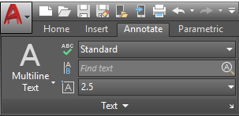
ANNOTATION
Text and Text Styles
• Multiline text (MTEXT) fills a bounding box; single-line text (TEXT) is quick labels.
• A text style names a collection of settings: font, height, spacing, justification.
• Create styles once (STYLE) and every note updates when the style changes.
• Annotative styles size text automatically to the viewport scale.
WSQ Technical Drawing with AutoCAD · TGS-2021005538
© 2026 Tertiary Infotech Academy Pte Ltd
115

Slide 116
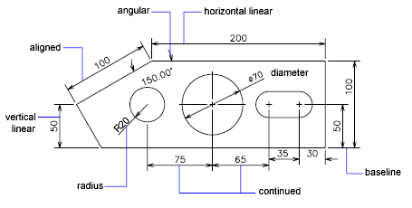
ANNOTATION
Dimensions — The Basic Types
• Linear and aligned dimensions measure edges; angular measures between lines.
• Radial and diameter dimensions measure arcs and circles, with centre marks.
• Arc-length and ordinate dimensions cover curved lengths and datum offsets.
• Continue chains dimensions end-to-end; Baseline stacks them from one datum.
WSQ Technical Drawing with AutoCAD · TGS-2021005538
© 2026 Tertiary Infotech Academy Pte Ltd
116

Slide 117
ANNOTATION
Dimension Styles
What a style controls
Arrowheads, extension lines, text placement, units and tolerances — consistently.
Create
DIMSTYLE → New: name it, set fit, text height and precision for your standard.
1
2
Apply
Set the style current before dimensioning; existing dimensions can be updated.
House rule
Never override individual dimension text — fix the style instead.
3
4
WSQ Technical Drawing with AutoCAD · TGS-2021005538
© 2026 Tertiary Infotech Academy Pte Ltd
117

Slide 118
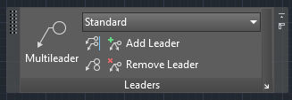
ANNOTATION
Multileaders and Revision Clouds
• A multileader is an arrowhead, landing line and note text (or block) in one object.
• MLEADER places it; add/remove leader lines and align multiple leaders neatly.
• Revision clouds flag changed areas for checking and approval.
• Draw a cloud by dragging, corner points — or convert an existing closed object.
WSQ Technical Drawing with AutoCAD · TGS-2021005538
© 2026 Tertiary Infotech Academy Pte Ltd
118

Slide 119
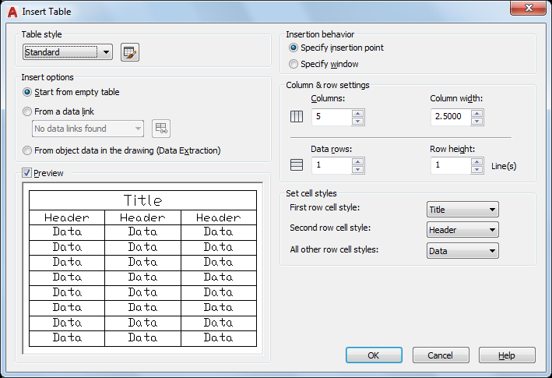
PART LISTS
Tables and Part Lists
• TABLE creates a compound object of rows and columns from a table style.
• Type into cells like a spreadsheet; formulas and fields are supported.
• DATAEXTRACTION fills a table from block attributes — the bill of materials.
• Tables can link to external Excel data and update both ways.
WSQ Technical Drawing with AutoCAD · TGS-2021005538
© 2026 Tertiary Infotech Academy Pte Ltd
119

Slide 120
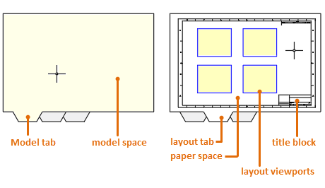
OUTPUT
Layouts and Viewports
• A layout is the 2D sheet environment: title block, viewports, annotation.
• MVIEW creates layout viewports — windows into model space.
• Set each viewport's scale exactly (e.g. 1:20), then lock it against accidental zooming.
• One model, many sheets: each layout composes its own views and scales.
WSQ Technical Drawing with AutoCAD · TGS-2021005538
© 2026 Tertiary Infotech Academy Pte Ltd
120

Slide 121
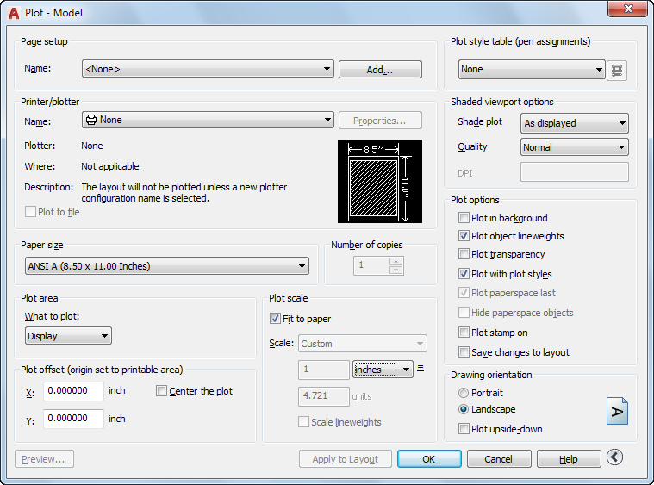
OUTPUT
Plotting and Printing
• Plot from the layout: choose plotter, paper size, plot area, scale and orientation.
• DWG To PDF.pc3 publishes the standard submission PDF.
• Page setups save the configuration per layout and import between drawings.
• Preview before plotting — check lineweights, scale and the full sheet.
WSQ Technical Drawing with AutoCAD · TGS-2021005538
© 2026 Tertiary Infotech Academy Pte Ltd
121

Slide 122
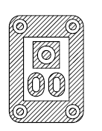
DETAIL
Hatching and Gradients
• HATCH fills enclosed areas with patterns (ANSI31 for sections), solids or gradients.
• Pick an internal point — island detection keeps text and holes clear.
• Scale and angle make adjacent parts read distinctly in section views.
• HATCHEDIT changes an existing hatch; hatches stay associative to their boundary.
WSQ Technical Drawing with AutoCAD · TGS-2021005538
© 2026 Tertiary Infotech Academy Pte Ltd
122

Slide 123
WHAT YOU'LL DO
Hands-On Labs — Design Documentation
Labs 13–14
Labs 15–16
—
• Text and Text Styles
• Dimensions, Multileaders and Part-List Tables
• Hatching and Detail Finishing
• Layouts, Viewports and Plotting
• —
WSQ Technical Drawing with AutoCAD · TGS-2021005538
© 2026 Tertiary Infotech Academy Pte Ltd
123

Slide 124
TOPIC 05 · HANDS-ON
Text and Text Styles
LAB 13
Annotate the layered table drawing with single-line and multiline text, create and apply text styles for titles and notes, and fill in the title-block fields.
You'll produce
An annotated drawing with consistent TITLE and NOTES text styles and a completed title block.
Commands: TEXT, MTEXT, STYLE, annotative text, SPELL
Files: labs/lab-13-text-and-text-styles/lab-table-lesson2.dwg
WSQ Technical Drawing with AutoCAD · TGS-2021005538
© 2026 Tertiary Infotech Academy Pte Ltd
124

Slide 125
LAB 13 · STEP-BY-STEP
Text and Text Styles
STEPS 1–3 OF 6
Open your table drawing and create text styles TITLE (Arial, 5mm) and NOTES (Arial, 2.5mm)
1
ST → New → font/height
Add the drawing title with single-line text on the A-TEXT layer
2
DT → start point → height → rotation
Add a general-notes paragraph with multiline text in a bounding box
3
T (MTEXT) → pick corners
WSQ Technical Drawing with AutoCAD · TGS-2021005538
© 2026 Tertiary Infotech Academy Pte Ltd
125

Slide 126
LAB 13 · STEP-BY-STEP
Text and Text Styles
STEPS 4–6 OF 6
Set the NOTES style current and re-style existing text via the Properties palette
4
PR → Style → NOTES
Fill in the title-block fields: title, drawn-by, date, scale, sheet number
5
double-click text → edit
Spell-check the drawing and save
6
SPELL → SAVE
WSQ Technical Drawing with AutoCAD · TGS-2021005538
© 2026 Tertiary Infotech Academy Pte Ltd
126

Slide 127
LAB 13 · VERIFY
Text and Text Styles
✅ Check your work
All annotation uses your named styles (none on Standard), the title block is complete, and changing the NOTES style font updates every note at once.
WSQ Technical Drawing with AutoCAD · TGS-2021005538
© 2026 Tertiary Infotech Academy Pte Ltd
127

Slide 128
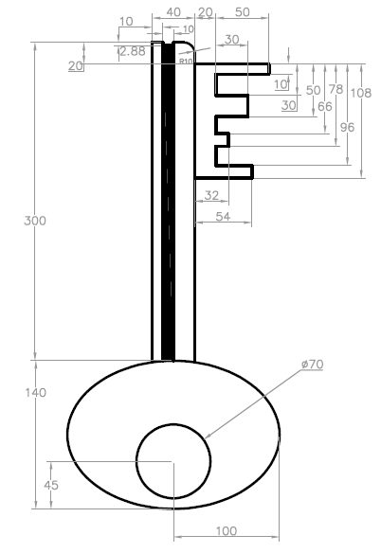
TOPIC 05 · HANDS-ON
Dimensions, Multileaders and Part-List Tables
LAB 14
Fully dimension practice drawing EX-8 with a metric dimension style — linear, aligned, radial, diameter, angular, continue and baseline — add multileader callouts, and create the part-list table from the Lab 11 balloon attributes.
You'll produce
A fully dimensioned EX-8 sheet with leader notes and a parts table (part no · description · qty).
Commands: DIMSTYLE, DIM, DIMLINEAR/ALIGNED/RADIUS/DIAMETER/ANGULAR, DIMCONTINUE, DIMBASELINE, MLEADER, TABLE, DATAEXTRACTION
Files: labs/lab-14-dimensions-multileaders-and-part-list-tables/ex8.dwg
WSQ Technical Drawing with AutoCAD · TGS-2021005538
© 2026 Tertiary Infotech Academy Pte Ltd
128

Slide 129
LAB 14 · STEP-BY-STEP
Dimensions, Multileaders and Part-List Tables
STEPS 1–3 OF 7
Open ex8.dwg and create dimension style MECH-25 (ISO, 2.5mm text, closed-filled arrows)
1
D (DIMSTYLE) → New → fit/text
Place linear and aligned dimensions on the main edges
2
DLI · DAL
Dimension the circles and arcs with diameter, radius and angular dimensions
3
DDI · DRA · DAN
WSQ Technical Drawing with AutoCAD · TGS-2021005538
© 2026 Tertiary Infotech Academy Pte Ltd
129

Slide 130
LAB 14 · STEP-BY-STEP
Dimensions, Multileaders and Part-List Tables
STEPS 4–6 OF 7
Chain related dimensions with Continue, and datum-reference them with Baseline
4
DCO · DBA
Add multileader callouts for the hole notes and edge finishes
5
MLD → arrow point → landing → note
Insert a table for the part list and populate it from the Lab 11 attribute extraction
6
TB (TABLE) · DATAEXTRACTION
WSQ Technical Drawing with AutoCAD · TGS-2021005538
© 2026 Tertiary Infotech Academy Pte Ltd
130

Slide 131
LAB 14 · STEP-BY-STEP
Dimensions, Multileaders and Part-List Tables
STEPS 7–7 OF 7
Add a revision cloud around one detail to flag it for checking, then save
7
REVCLOUD → drag around detail
WSQ Technical Drawing with AutoCAD · TGS-2021005538
© 2026 Tertiary Infotech Academy Pte Ltd
131

Slide 132
LAB 14 · VERIFY
Dimensions, Multileaders and Part-List Tables
✅ Check your work
Every dimension on the EX-8 sheet is reproduced with the MECH-25 style (no overridden text), leaders land neatly, and the table rows match the balloons one-for-one.
WSQ Technical Drawing with AutoCAD · TGS-2021005538
© 2026 Tertiary Infotech Academy Pte Ltd
132

Slide 133
TOPIC 05 · HANDS-ON
Hatching and Detail Finishing
LAB 15
Apply section hatching to the closed areas of a section view — pattern, scale and angle — use gradient fills for presentation, and control hatch boundaries and islands.
You'll produce
A section view with correct ANSI/ISO hatch patterns and a presentation-filled elevation.
Commands: HATCH (pattern/scale/angle), gradient fills, boundary/island detection, HATCHEDIT
Files: labs/lab-15-hatching-and-detail-finishing/ex3.dwg
WSQ Technical Drawing with AutoCAD · TGS-2021005538
© 2026 Tertiary Infotech Academy Pte Ltd
133

Slide 134
LAB 15 · STEP-BY-STEP
Hatching and Detail Finishing
STEPS 1–3 OF 6
Open a drawing with closed profiles (reuse ex3-mine.dwg) and identify the cut areas
1
Hatch the main section area with ANSI31 at a scale that reads clearly
2
H → Pattern ANSI31 → pick point
Set different angles for adjacent parts so the section reads unambiguously
3
H → Angle 90 → pick point
WSQ Technical Drawing with AutoCAD · TGS-2021005538
© 2026 Tertiary Infotech Academy Pte Ltd
134

Slide 135
LAB 15 · STEP-BY-STEP
Hatching and Detail Finishing
STEPS 4–6 OF 6
Control islands: hatch around text and holes using island detection
4
H → Settings → Island detection
Apply a two-colour gradient fill to the elevation face for presentation
5
GRADIENT → colours → pick area
Edit an existing hatch's pattern and scale, then save
6
HATCHEDIT → new scale
WSQ Technical Drawing with AutoCAD · TGS-2021005538
© 2026 Tertiary Infotech Academy Pte Ltd
135

Slide 136
LAB 15 · VERIFY
Hatching and Detail Finishing
✅ Check your work
Hatches stay inside their boundaries (no bleed), adjacent parts hatch at different angles, and text/holes remain unhatched islands.
WSQ Technical Drawing with AutoCAD · TGS-2021005538
© 2026 Tertiary Infotech Academy Pte Ltd
136

Slide 137
TOPIC 05 · HANDS-ON
Layouts, Viewports and Plotting
LAB 16
Compose an A3 layout: attach the title block, create scaled viewports (1:20 and a detail), lock them, and plot the sheet to PDF — the standard submission output.
You'll produce
A print-ready A3 layout with title block, two locked scaled viewports and a plotted PDF.
Commands: LAYOUT, PAGESETUP, MVIEW, viewport scale/lock, PLOT, DWG to PDF.pc3
Files: labs/lab-16-layouts-viewports-and-plotting/title-block.dwg
WSQ Technical Drawing with AutoCAD · TGS-2021005538
© 2026 Tertiary Infotech Academy Pte Ltd
137

Slide 138
LAB 16 · STEP-BY-STEP
Layouts, Viewports and Plotting
STEPS 1–3 OF 6
Open your annotated drawing, switch to a Layout tab and rename it A3-SHEET
1
right-click tab → Rename
Set the page: DWG To PDF.pc3, ISO A3 (420×297), landscape, 1:1 plot scale
2
PAGESETUP → Modify
Insert the title block on the layout at 0,0 in paper space
3
I → title-block
WSQ Technical Drawing with AutoCAD · TGS-2021005538
© 2026 Tertiary Infotech Academy Pte Ltd
138

Slide 139
LAB 16 · STEP-BY-STEP
Layouts, Viewports and Plotting
STEPS 4–6 OF 6
Create a main viewport and set its scale to 1:20 exactly, then lock it
4
MV → drag → select → scale 1:20 → lock
Add a second, smaller viewport for a detail at a larger scale
5
MV → drag → scale 1:5
Plot the layout to PDF and check line weights in the output
6
PLOT → DWG To PDF.pc3 → OK
WSQ Technical Drawing with AutoCAD · TGS-2021005538
© 2026 Tertiary Infotech Academy Pte Ltd
139

Slide 140
LAB 16 · VERIFY
Layouts, Viewports and Plotting
✅ Check your work
Both viewports report their exact scales in the status bar and cannot be zoomed when locked, and the plotted PDF shows the complete titled sheet at A3.
WSQ Technical Drawing with AutoCAD · TGS-2021005538
© 2026 Tertiary Infotech Academy Pte Ltd
140

Slide 141
TOPIC RECAP
Recap — Design Documentation
Lab 13 — Text and Text Styles
An annotated drawing with consistent TITLE and NOTES text styles and a completed title block.
Lab 14 — Dimensions, Multileaders and Part-List Tables
A fully dimensioned EX-8 sheet with leader notes and a parts table (part no · description · qty).
1
2
Lab 15 — Hatching and Detail Finishing
A section view with correct ANSI/ISO hatch patterns and a presentation-filled elevation.
Lab 16 — Layouts, Viewports and Plotting
A print-ready A3 layout with title block, two locked scaled viewports and a plotted PDF.
3
4
WSQ Technical Drawing with AutoCAD · TGS-2021005538
© 2026 Tertiary Infotech Academy Pte Ltd
141

Slide 142
WRAP-UP
Course Summary & Next Steps
WSQ Technical Drawing with AutoCAD · TGS-2021005538
© 2026 Tertiary Infotech Academy Pte Ltd
142

Slide 143
LEARNING OUTCOMES
What You Achieved
Getting started
Navigated the AutoCAD UI, workspaces, units and precision drafting aids.
Technical drawing
Produced accurate 2D drawings and isometric views from dimensioned sheets.
1
2
Modifying objects
Built designs efficiently with move/copy, offset, trim, fillet and arrays.
Organizing objects
Structured drawings with layers, blocks, attributes and external references.
3
4
Design documentation
Dimensioned, annotated, tabulated part lists and plotted submission-ready sheets.
5
WSQ Technical Drawing with AutoCAD · TGS-2021005538
© 2026 Tertiary Infotech Academy Pte Ltd
143

Slide 144
TEST YOURSELF · EXAMS.TERTIARYINFOTECH.COM
Practice Exam
• Sharpen your readiness with the Tertiary Infotech AutoCAD practice exam.
• Go to exams.tertiaryinfotech.com → Practice Exams → Autodesk → AutoCAD.
• Attempt it under timed conditions and review every explanation.
• Revisit any lab whose topic you miss, then re-take the practice exam.
✓
AutoCAD Practice Exam
exams.tertiaryinfotech.com
Timed questions with explanations,
mapped to the five course topics
WSQ Technical Drawing with AutoCAD · TGS-2021005538
© 2026 Tertiary Infotech Academy Pte Ltd
144

Slide 145
KEEP LEARNING
Recommended Next Courses
Architecture Drawing with Revit
WSQ · Tertiary Infotech Academy
Product Design with Fusion 360
WSQ · Tertiary Infotech Academy
1
2
AutoCAD Civil 3D for Infrastructure Design
WSQ · Tertiary Infotech Academy
Technical Drawing with AutoCAD Mechanical
WSQ · Tertiary Infotech Academy
3
4
Technical Drawing with AutoCAD Electrical
WSQ · Tertiary Infotech Academy
5
WSQ Technical Drawing with AutoCAD · TGS-2021005538
© 2026 Tertiary Infotech Academy Pte Ltd
145

Slide 146
WE'RE HERE TO HELP
Support
• If you have any enquiries during and after the class, contact us:
• Email: enquiry@tertiaryinfotech.com
• Tel: +65 6100 0613
• Website: www.tertiarycourses.com.sg
WSQ Technical Drawing with AutoCAD · TGS-2021005538
© 2026 Tertiary Infotech Academy Pte Ltd
146

Slide 147
BEFORE YOU LEAVE
Cert & TRAQOM Survey (Mandatory)
• Complete the TRAQOM course-quality survey on the LMS — it is mandatory for WSQ funding.
• Your e-certificate is issued on the LMS after you are assessed Competent and the survey is done.
• Portal: https://lms-tms.tertiaryinfotech.com
WSQ Technical Drawing with AutoCAD · TGS-2021005538
© 2026 Tertiary Infotech Academy Pte Ltd
147

Slide 148
ASSESSMENT
Final Assessment
• Written Assessment (WA) — Short-Answer Questions (SAQ), 1 hour, open book.
• Practical Performance (PP) — produce a dimensioned AutoCAD technical drawing, 1.5 hours, open book.
• Open book: slides, Learner Guide and approved materials only.
• Remember to take the Assessment digital attendance (TRAQOM).
• Submit your completed answers and DWG files on the LMS at https://lms-tms.tertiaryinfotech.com.
WSQ Technical Drawing with AutoCAD · TGS-2021005538
© 2026 Tertiary Infotech Academy Pte Ltd
148

Slide 149
ON ASSESSMENT DAY
Assessment Flow
1
2
3
4
5
▶
▶
▶
▶
TRAQOM survey — scan the QR code on the LMS
Assessment digital attendance — scan the SSG QR
Sit WA (SAQ) then Practical Performance — open book
Submit your answers and DWG file on the LMS
Sign the Assessment Summary Record
WSQ Technical Drawing with AutoCAD · TGS-2021005538
© 2026 Tertiary Infotech Academy Pte Ltd
149

Slide 150
TRAQOM · SSG DIGITAL ATTENDANCE
Digital Attendance (Mandatory)
• It is mandatory to take the AM, PM and Assessment digital attendance for WSQ-funded courses.
• The trainer/administrator displays the digital attendance QR code from the SSG portal.
• Scan the QR code with your mobile phone camera and submit your attendance.
• A minimum of 75% attendance is required to be eligible for assessment and funding.
WSQ Technical Drawing with AutoCAD · TGS-2021005538
© 2026 Tertiary Infotech Academy Pte Ltd
150

Slide 151
HAPPY DRAFTING
Thank You!
You are now ready to read, produce and document technical drawings with AutoCAD.
WSQ Technical Drawing with AutoCAD · TGS-2021005538
© 2026 Tertiary Infotech Academy Pte Ltd
151

